Slide 1
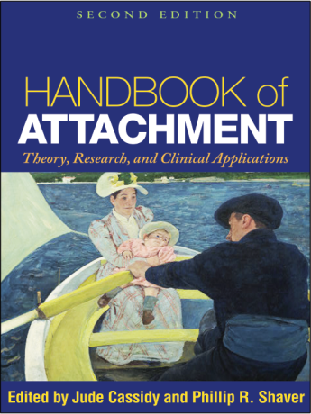
Dissecting Adult Attachment Processes:
An Attachment Perspective on Relational Motives and Dynamics
Part 1
Phillip R. Shaver and Mario Mikulincer
Amsterdam
April 2013
Notes:
1

Slide 2
Overview
Goal: To convey some of what we have learned while pursuing an adult extension of Bowlby and Ainsworth’s attachment theory and related infant-mother research
Brief background: attachment theory and its extension — by social/personality psychologists — into the domain of adolescent and adult relationships
Our model of attachment-system functioning in adolescence and adulthood
Sample research on working models in dreams and other narratives, attachment-system activation, ambivalence, emotion regulation in behavior and the brain, and ‘caregiving’ in couple relationships

Slide 3
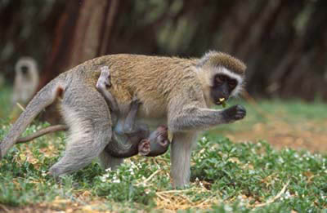
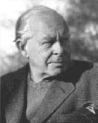


Bowlby’s attachment theory
Created by John Bowlby, a British psychoanalyst, based partly on primate ethology, to explain why “maternal deprivation” so often leads to later anxiety, anger, delinquency, and depression
He published five major books about the theory between 1969 and 1988, including one on psychotherapy

Slide 4

Ainsworth’s contribution, a great gift to Bowlby
Bowlby’s theory was first tested on infants and their mothers by Mary Ainsworth, an American psychologist, and her colleagues (whose major book appeared in 1978)
She invented a laboratory procedure, the Strange Situation, to assess the quality of an infant’s attachment to mother. Classifications based on this measure have been shown, in 30-year longitudinal studies, to predict ― in conjunction with later experiences ― mental health and relationship quality

Slide 5
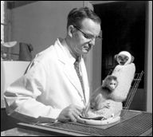
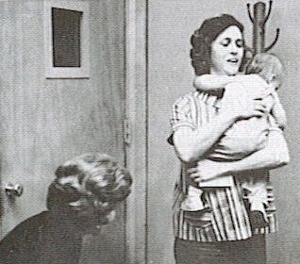
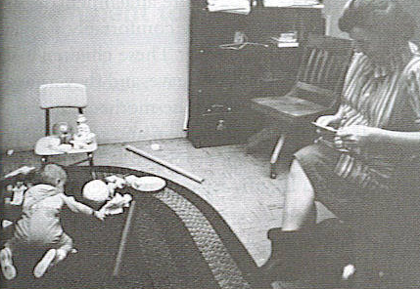
Harlow’s monkeys and Ainsworth’s “Strange Situation”
Secure attachment facilitates exploration; insecure attachment interferes with it

Slide 6

Attachment theory distilled
Humans, especially infants, rely on attachment figures for protection, support, and help with emotion regulation
The attachment behavioral system is an evolved, innate regulator of proximity (hence of safety and safe exploration)
When threats abate, behavioral systems other than attachment (e.g., exploration, caregiving) can be activated, allowing a person to become more competent/autonomous
Attachment orientations, or “styles,” develop in relationships, resulting in systematic individual differences in attachment orientation: secure, anxious, avoidant, . . .
The theory applies from “the cradle to the grave” (Bowlby)

Slide 7

A 1000-page summary of basic and applied attachment theory and research, published in 2008

Slide 8
Adult attachment ‘styles’ in social/personality psychology: Regions in a two-dimensional space
HIGH AVOIDANCE
DISMISSING AVOIDANT
FEARFUL AVOIDANT
LOW ANXIETY
HIGH ANXIETY
SECURE
PREOCCUPIED
LOW AVOIDANCE
Adapted from Ainsworth et al. (1978), Bartholomew
& Horowitz (1991), Fraley & Shaver (2000)

Slide 9
Self-report attachment measure
(Brennan, Clark, & Shaver, 1998)
Avoidance (18 items, α > .90)
1. I prefer not to show a partner how I feel deep down.
2. I try to avoid getting too close to my partner.
3. I feel comfortable depending on relationship partners. (reverse-scored)
I turn to a relationship partner for many things, including comfort and reassurance. (reverse-scored)
Anxiety (18 items, α > .90)
1. I don’t often worry about being rejected or abandoned. (reverse-scored)
2. I need a lot of reassurance that I am loved by a partner.
3. I get frustrated if a relationship partner is not available when needed.
I resent it when a partner spends time away from me.

Slide 10
Since Hazan & Shaver (1987) . . .
Hundreds of studies using self-report attachment measures have been conducted
The findings can be summarized in a three-part model (Mikulincer & Shaver, 2007, and elsewhere)

Slide 11
+
Signs of threat?
Activation of other behavioral systems
No
-
Yes
Attachment-system activation
attachment security, distress alleviation
Security-based strategies
+
Is attachment figure available?
-
Yes
No
Insecurity, distress compounding
Is proximity seeking a viable option?
Deactivating strategies
No
Yes
Hyperactivating strategies

Slide 12
Aspects of the theory to be considered in this first of today’s two-part presentation
Mental representations of self and others (Bowlby’s “internal working models”)
Attachment system activation in the lab
Attachment insecurities and emotion regulation
Ambivalence
Attachment, caregiving, and sex in couple relationships

Slide 13
First Issue
Attachment Insecurities and Mental Representations of Self and Others
(in Dreams and Attachment-Related Mental Scripts)

Slide 14
Attachment insecurities and dreams
(Mikulincer, Shaver, & Avihou-Kanza, A&HD, 2011)
Participants were asked to recall dreams each morning for 30 days and write a brief account of each one, yielding 14 dreams apiece, on average
Two ‘blind’ independent judges used Luborsky’s Core Conflictual Relationship Themes coding system to characterize how dreamers represented self and others.
Dreams reported by individuals high in attachment anxiety included more representations of self as anxious, weak, and helpless, and more portrayals of others as unloving.
Avoidant attachment was associated with representations of self as less responsive (more distant, uncooperative, unexpressive, and angry) toward cold or hostile others.

Slide 15
Sample secure dream
Reported by a young woman who scored low on both the anxiety and avoidance scales of the ECR, and whom regard as secure:
I was sitting in my elementary school library reading a book, which seemed very natural even though I haven’t been there for years. I spoke with friends and teachers, and the place was just as it used to be. The principal came in and started yelling at us, saying we were barbaric children. At first I thought we might have been noisy and deserved this rebuke, but I told him that, despite whatever bad behavior we engaged in, we didn’t deserve such treatment and he had overlooked my many good qualities. I felt that despite being a little girl, I had enough self-esteem to tell him he was wrong. So I got up and told him I was not a barbarian and I came to the library to read books that I like. He then apologized. I felt proud of myself. At that instant, my mom appeared, hugged me, and said I was okay and she was also proud of me. (I don’t know how my mom got there.) She then took me to some fun place; I don’t know where. I just remember that we laughed a lot and bought some silly things – maybe in a mall.

Slide 16
Sample anxious dream
Reported by a young man who scored high on attachment anxiety:
I’m arguing with friends about who teaches a particular course. I start running toward the city and see a bank robbery in progress. Suddenly I realize that I am the bank robber! I’m debating with myself about whether I should break into the bank or not, and I decide that I should. I get into the bank and yell, “Give me the money!” The teller stoops down below the counter, gets the money, and hands it to me, and I run away. While exiting the bank, I shoot three times in the air and then run down the street with the weapon wrapped in a quilt. While running, I suddenly think about what I’ve done and what a bad person I am: “Maybe I hit someone while shooting in the air.” I’m debating with myself about where to run and suddenly notice that the money has disappeared. I think, “Why can’t I do something right for once?” I want to cry. Suddenly the cops arrive. I say, “Take me. Maybe it’s for the best that I go to jail. No one cares about me anyhow.” I feel really ashamed of what I did. Suddenly my dad appears and yells at me: “How dare you do such a foolish thing! You deserve to go to jail. You’re worthless.” It hurts, but I know that what he says is true.

Slide 17
Sample avoidant dream
Reported by a young woman who scored high on avoidant attachment:
My parents wanted me to go with them to my grandma’s house, and a discussion ensued about whether it was worth going and if she would or wouldn’t have food for us. I said I didn’t want to go, and I went into the backyard alone. There was a “cat party” going on, and many disgusting, filthy black cats were sitting in a circle, facing out, with their backs toward each other. Every cat screamed, one at a time, and if the cat opposite to that one correctly identified the screamer, that cat won. I sat in the corner with my computer and was afraid to move. I thought, “Why didn’t they run away when they saw me?” I realized that because there were so many of them, they knew they had power over me and could easily wipe me out. Suddenly, my computer fell and landed close to the cats. I had to save it, so I got closer to them, but when I did, they jumped on the computer and threatened me with aggressive expressions and horrible screams. They started to sing, “If you don’t go home, you’ll have to tell us who is a nice cat.” I had to answer with a song saying that all of them were nice. They then let me have my computer. I wanted to destroy them one by one, but instead I went inside with the computer . . . and woke up in terror.

Slide 18
Knowledge of the “secure-base script”
(Mikulincer, Shaver, et al., JPSP, 2009)
Harriet Waters showed that attachment security, measured in children, is related to implicit understanding of what she calls the secure-base script: “If I’m threatened or distressed, I can turn to an attachment figure for help, I will be comforted, and I can then return safely to other matters.”

Slide 19
Empirical findings
(Mikulincer, Shaver, et al., JPSP, 2009)
We conducted multiple studies in which people were asked, for example, to describe what was happening in a series of drawings that form an outline of the beginning of the secure-base script. (Similar to a TAT.)
In Study 1, the richness, or completeness, of people’s responses were predicted by the ECR anxiety and avoidance dimensions: ß = -.35 for anxiety and ß = -.45 for avoidance (and this was not due to narrative length or verbal ability).

Slide 20
More on the “secure-base script”
In Study 2, participants saw only the first picture from the previous series of four, showing a person in distress, and they wrote about what would happen next.
Insecure (anxious and/or avoidant) participants were less likely to include all parts of the secure-base script. But the two kinds of insecurity were associated with different gaps in the script.
Anxious people’s stories tended to lack the final step (relief and return to other activities), whereas avoidant people’s stories tended to lack the part about actively seeking others’ support).
That is, anxious people more often wrote about an injured protagonist who was seeking support and not achieving relief, whereas avoidant participants more often wrote about a person achieving relief without seeking or receiving support. (The results were not due to neuroticism, extraversion, or verbal ability.)

Slide 21
Further studies of insecure scripts
(Ein-Dor, Mikulincer, & Shaver, JPSP, 2011)
In five studies we identified two kinds of scripts that insecure people use in response to threats:
  A sentinel script, characteristic of anxious individuals, who focus intently on possible threats, detect them quickly, and immediately communicate about them to others (which can sometimes be useful to others, but is often viewed as an annoyance)
  A rapid fight-flight script, characteristic of avoidant individuals, who rapidly find a way to deal with a threat by attacking the problem or fleeing (which can also benefit others, even though the response is usually not altruistic in intent)
The social benefits of these scripts is discussed in a theoretical paper (Ein-Dor, Mikulincer, Doron, & Shaver, PoPS, 2010).

Slide 22
Second Issue:
Attachment-System Activation
(in the Lab)

Slide 23
The attachment system can be unconsciously activated
(Mikulincer et al., JPSP, 2000)
Subliminal (22 millisecond) priming with a threat word (e.g., failure, illness, death) heightens mental accessibility of attachment-related concepts –- e.g., faster responses to attachment-related words (e.g., love, hug, secure, close) in a lexical decision task
Secure people activate positive but not negative attachment concepts; anxious people activate both positive and negative concepts; avoidant people activate both, but activate the negative ones only when a “cognitive load” is added
This suggests that anxiety and avoidance are (as theorized) rooted in earlier painful experiences with attachment figures, and that avoidance requires effortful suppression or repression

Slide 24
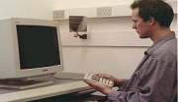
(Sample fixation point,
shows for 500 milliseconds)
X
X

Slide 25
(subliminal, invisible prime word, shown for 22 ms and then masked)
death

Slide 26
(visible target word)
love
(stays visible until the person presses a key indicating it is either a word or not a word: e.g., evlo)

Slide 27
More about attachment-system activation
Subliminal priming with a threat word (e.g., failure, separation) increases accessibility of attachment figures’ names but not names of other familiar people (Mikulincer, Gillath, & Shaver, JPSP, 2002).
Attachment anxiety correlates with faster access to attachment figures’ names regardless of threat (perhaps an example of anxious vigilance)
Avoidant attachment correlates with slower access to attachment figures’ names (suppression) when the threat word is “separation,” but not “failure” (so the suppression may be somewhat attachment-specific)
We have obtained similar results among religious people for “God” and God-related concepts (e.g., a Torah scroll), suggesting that God can serve as an attachment figure (Granqvist, Mikulincer, & Shaver, PSPR, 2010; JPSP, 2012)

Slide 28
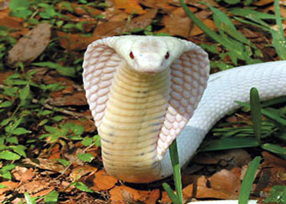

An interesting attachment-formation study (Beckes et al., 2010, Psych. Science), using some of our methods
They presented subliminal pictures of a striking snake, a mutilated body, or a neutral stimulus
Followed by a supraliminal picture of a
smiling woman’s face or a control face
Measured reaction times in a lexical decision task to security-related words (safe, kind, protect, secure, trust, warm) and insecurity-related words (alone, anxiety, threat, distress, rejection, despair, needy) in the presence of the pictured face.
Found an interaction: The secure words were perceived faster and the insecure words slower in the presence of the smiling face if it had been paired unconsciously with the frightening stimuli.

Slide 29
Third Issue:
Emotion Regulation

Slide 30
Avoidant attachment and emotion regulation
Avoidant individuals inhibit or block emotional states that are incongruent with the goal of keeping their attachment system deactivated
Avoidant inhibition and suppression require mental effort, and hence can be over-ridden by cognitive load and stress
Two examples . . .

Slide 31
Color-naming times (in msec) for separation words during a Stroop task
Avoidant people showed no “rebound” of separation-related thoughts when not under a high cognitive load, but they couldn’t avoid the rebound under a high load (Mikulincer, Dolev, & Shaver, JPSP, 2004)

Slide 32
Broader summary of findings regarding suppression of thoughts of loss/rejection
Under low load conditions, avoidant people are able to suppress thoughts of loss and defensively activate positive self-representations
Under high load, they can’t suppress thoughts of loss or negative self-representations, suggesting (as in other studies) that their defensive strategies require constant effort
Not emphasized here but true: Anxious people in our studies seem unable to suppress thoughts of loss or negative self-traits

Slide 33
A real-world example: Mothers with a CHD child (Berant, Mikulincer, & Shaver, 2008)
Participants: 63 mothers of children diagnosed with CHD during their first months of life; they underwent three waves of data collection (immediately following diagnosis, a year later, and 7 years later)
Measures: A physician’s rating of CHD severity at T1; ECR-like attachment scales given to the mother at T1, an overall maternal mental health scale given at T’s 1, 2, and 3; a marital quality scale given at T’s 1, 2, and 3; a child-appropriate explicit self-concept measure and the CAT (projective story measure) given to the child at T3 (when he/she was 7 or 8 years old)

Slide 34
A few results
Mother’s avoidance at T1 and the interaction of her avoidance with the child’s CHD severity predicted a decline over time in her marital quality and mental health. Non-avoidant mothers showed no such deterioration, regardless of child’s CHD severity.
Mother’s avoidance and anxiety at T1 predicted child’s poorer explicit self-concept at age 7-8. Also, the child’s “dominant affect” (in the CAT) was more negative at age 7-8 if the mother had been more avoidant 7 years earlier.
In general, the stress of having a child with severe CHD was too much for more avoidant mothers to handle, perhaps because avoidant coping collapsed under a high “coping load.”

Slide 35
Attachment anxiety and intensification of emotion
As mentioned, anxious individuals seem unable (or unwilling?) to suppress negative emotions
To learn more about their intense emotionality, we used neuroimaging (fMRI)

Slide 36
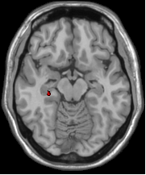
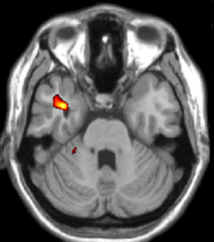
Regions in which attachment anxiety correlates .74**/.64** with activation during thoughts of loss (Gillath et al., NeuroImage, 2005)
L
R
Left anterior temporal pole
  associated with recall of sad thoughts (Lévesque et al., 2003)
  activation during negative thoughts (Think Negative > Think Neutral) was correlated with attachment anxiety (r = .74**)
Left hippocampus
  associated with memory retrieval (Eichenbaum, 2004)
  activation during negative thoughts was correlated with attachment anxiety (r = .64**)
  cf. behavioral studies by Mikulincer & Orbach (1995)
Notes:
We didn’t see differences when looking at the group as a whole associated to attachment-related negative emotions, but when we took anxiety into account we found activation in the temporal pole (amygdala), hippocampus, and ACC

Slide 37
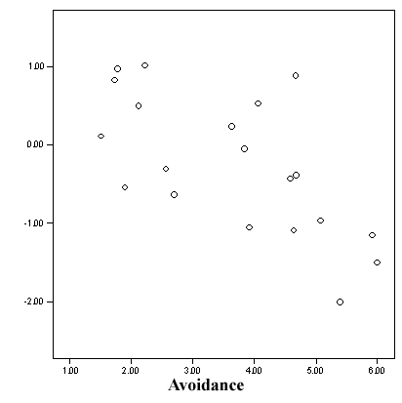
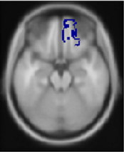
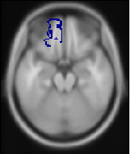
Suppressing negative thoughts:
Negative correlation with attachment anxiety
Activation in orbitofrontal cortex (OFC; BA 11)
L
R
L
R
Don’t Think > Think (contrast values)
Attachment Anxiety
Associated with emotional control (e.g., Shimamura & Knight, 2002)
Thus, anxious people have, or exert, less emotional control than non-anxious people when explicitly asked to exert control

Slide 38
Fourth Issue:
Attachment Insecurity and Relational Ambivalence

Slide 39
Experimental studies of ambivalence
(Mikulincer, Shaver, Bar-On, & Ein-Dor, JPSP, 2010)
“Ambivalence” was one of the terms Ainsworth used to characterize anxious attachment to mother in infancy: “anxious-ambivalence.”
In the Strange Situation, infants classified as anxiously attached to mother were ambivalent during reunions, approaching and clinging at one moment, angrily arching their backs and refusing to be calmed the next. They wanted closeness but also resisted it.
We wanted to see whether we could measure relational ambivalence in laboratory studies of college-aged adults.

Slide 40
Study 1 – Aims and rationale
In Study 1, we asked whether high scorers on the ECR measure of anxious attachment exhibit simultaneous activation of approach and avoidance tendencies, and at both explicit and implicit levels.
Both measures are important because high scores on explicit measures wouldn’t necessarily indicate that approach and avoidance tendencies coexisted in a person’s unconscious goal structure.

Slide 41
Study 1 - Method
110 university students (81 women, 29 men) currently involved in a romantic relationship completed the ECR measure of attachment anxiety and avoidance.
Explicit (conscious) relational ambivalence was assessed with the Ambivalence in Intimate Relationships scale (Thompson & Holmes, 1996).
In the AIR, participants were asked to describe their positive and negative feelings toward six traits of their romantic partner (e.g., his/her emotional closeness, relationship commitment).

Slide 42
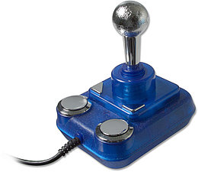
Study 1 - Method
Implicit relational ambivalence was assessed
with an approach-avoidance task developed
by Chen and Bargh (1999).
Participants were exposed to positive and negative words related to closeness and distance from relationship partners, as well as positive and negative non-attachment words.

Slide 43
Study 1 - Method
On each trial, they were asked either to pull a joystick (a lever) back toward themselves (approach/closeness response) or to push the lever away from themselves (avoidance response) when they recognized a word, and latencies for initiating these responses were recorded.
We defined ambivalence as the co-existence of approach and avoidance tendencies to the same stimulus. We computed three scores for each participant by averaging ambivalence scores for (a) attachment-irrelevant words, (b) closeness words, and (c) distance words.

Slide 44
Study 1 - Results
Measure | β Anxiety | β Avoidance
Explicit ambivalence | .49** | -.06
Implicit ambivalence toward closeness words | .28** | .01
Implicit ambivalence toward distance words | .24* | .11
Notes: * p < .05; ** p < .01

Slide 45
Study 2 – Aims and rationale
In Study 2, we hypothesized that attachment-anxious people’s ambivalence would be intensified by both (a) signs of a partner’s interest/liking and (b) signs of a partner’s rejection.
That is, attachment-anxious people would react to a partner’s expression of interest not only with approach tendencies but also with fear of rejection (causing avoidance as well as approach).
They would also react to a partner’s expressions of rejection not only with self-protective avoidance tendencies but also with desperate wishes for affection and security (i.e., approach tendencies).

Slide 46
Study 2 – Method
90 Israeli students (54 women and 36 men) completed the ECR scale and interacted with an opposite-sex confederate and were randomly divided into three conditions:
  (a) Liking (the confederate expressed interest in working together with the participant).
  (b) Rejection (the confederate expressed a preference for working alone rather than with the participant).
  (c) Control (the confederate did not signal liking or rejection).
Participants then completed the approach-avoidance task used in Study 1, assessing implicit ambivalence toward closeness and distance words.

Slide 47
Study 2 – Results
Effects | β Ambivalence toward closeness words
Attachment anxiety | .32*
Attachment avoidance | -.14
Partner’s liking | .16
Partner’s rejection | -.10
Anxiety x liking | .27*
Avoidance x liking | .01
Anxiety x rejection | .26*
Avoidance x rejection | -.07
Notes: * p < .05; ** p < .01

Slide 48
Study 2 - Results
The link between attachment anxiety and implicit ambivalence toward closeness words was significant in the liking and the rejection condition, but not in the control condition.
Additional analyses revealed that being liked or rejected by the confederate created greater ambivalence toward closeness words when attachment anxiety was relatively high, but not when it was relatively low

Slide 49
Study 2 – Results
Effects | β Ambivalence toward distance words
Attachment anxiety | .20*
Attachment avoidance | .11
Partner’s liking | .12
Partner’s rejection | .11
Anxiety x liking | .17
Avoidance x liking | -.01
Anxiety x rejection | .19
Avoidance x rejection | .34*
Notes: * p < .05; ** p < .01

Slide 50
Study 2 - Results
Attachment anxiety was slightly associated with implicit ambivalence toward distance words.
Avoidant attachment was associated with implicit ambivalence toward distance words only in the rejection condition.
That is, the experience of a potential relationship partner’s rejection caused the more avoidant participants to react to distance words with greater implicit ambivalence (reminiscent of our earlier finding for the word “separation” in the lexical decision study).

Slide 51
Fifth Issue:
Couple Relationships

Slide 52
Romantic love (couple pair-bonding) can be conceptualized as the integration of 3 behavioral systems discussed by Bowlby: attachment, caregiving, and sex
Sex
Caregiving
Pair
bonding
Hazan and Shaver (1987)
Attachment

Slide 53
Attachment and sex
Many studies have shown that attachment anxiety and avoidance are related to sexual motives, fantasies, and behavior (e.g., Schachner & Shaver, 2004)
Anxious people tend to use sex, sometimes without due caution, to get a partner’s attention, feel more loved, and bind their partner into the relationship
Avoidant people tend to begin sex later but then become more promiscuous than anxious and secure people in adulthood; they tend to use sex to boost self-esteem and reputation among peers, but not to feel psychologically intimate with their partner (more “one-night stands”)
Both kinds of insecure people have shorter relationships than secure people, on average

Slide 54
A survey study of sexuality
We (Brassard, Shaver, & Lussier, 2007) surveyed a representative sample of 273 French-Canadian heterosexual couples aged 18–35.
Avoidant attachment was significantly related to two strategies for limiting sexual intimacy: avoidance of sexual encounters and avoidance of sexual fantasies about the partner (women only).
Anxious attachment appeared to interfere with comfortable intimacy, especially among men, who viewed their partner as avoiding sex and applied more pressure to have sex.

Slide 55
Attachment and sexuality in couples seeking marital therapy
A large clinical sample of 242 French-Canadian couples seeking marital therapy completed the ECR and the Index of Sexual Satisfaction (Brassard, Péloquin, Dupuy, Wright, & Shaver, 2012).
Results showed that both attachment anxiety and avoidance predicted individuals’ own sexual dissatisfaction (actor effects).
We also observed 2 partner effects: (a) anxiety in men predicted female partners’ sexual dissatisfaction and (b) avoidance in women predicted male partners’ sexual dissatisfaction.

Slide 56
A daily diary study of sexual fantasies
(Birnbaum, Mikulincer, & Gillath, PSPB, 2011)
Young Israeli couples kept daily diaries concerning sexual fantasies and described aspects of their relationship functioning for 21 days.
Avoidant attachment was related to sexual fantasies that emphasized non-intimacy, control of sexual interactions, and negative views of fantasy sexual partners.
Anxious attachment was related to sexual fantasies that emphasized desires for closeness, perception of the self as weak and dependent, and perception of fantasy sexual partners as cruel and abusive.

Slide 57
Attachment and caregiving
Many studies have shown that attachment anxiety and avoidance are related to deficits in caring for relationship partners and engaging in altruistic behavior more generally (e.g., Kunce & Shaver, 1994; Gillath et al., 2005).
Anxious people tend to be self-focused when engaged in supposedly caring/altruistic actions, leading to intrusiveness, poor assessment of others’ actual needs, and personal distress.
Avoidant people tend to be less interested in helping others and to derogate needy others. They are relatively deficient in the domain of compassion and love.

Slide 58
A current project: Overcoming ‘mental depletion’ when offering support to a partner
(studied in Israel and in Davis: Mikulincer, Shaver, Sahdra, & Bar-On, A&HD, in press)
Both members of college-student couples (involved for at least 6 months) were invited to complete questionnaire measures on a website and participate in a lab experiment.
Each partner independently entered a website from home or work and completed measures, including the Experiences in Close Relationship Scales (attachment anxiety and avoidance)
Each partner provided names of people (other than their partner) who were their security providers (using the WHOTO Scale), as well as the names of unfamiliar people (from a list we provided)
Notes:
58

Slide 59
Methods
Couples came to the lab and were informed that they would be videotaped during an interaction in which one of them (whom we view as “the care-seeker”) disclosed a personal problem to the other (“the caregiver”).
After the instructions, one experimenter took the “caregiver” to another room where security priming and cognitive depletion manipulations were applied.
The second experimenter remained with the “care-seeker” and asked him or her to think and write about any bothersome personal problem that he or she could discuss (except one that involved conflict with the partner).
Notes:
59

Slide 60
Methods (continued)
Caregivers performed a Stroop color-naming task during which they were randomly assigned to one of two priming conditions:
  Security Priming: Subliminal exposure (for 20 milliseconds on each trial) to names of security providers nominated in the WHOTO questionnaire (not including the romantic partner).
  Neutral Priming: Subliminal exposure to names of unfamiliar persons.
Notes:
60

Slide 61
Methods (continued)
Half of the caregivers in each priming condition were asked to state aloud the color of a word as it appeared on the computer screen (e.g., the word GREEN printed in blue). This procedure is known to create cognitive depletion (mental fatigue).
The other half of the caregivers were asked to state aloud the color of a word which also named the color, which did not require overriding automatic responses and hence did not result in depletion.
Notes:
61

Slide 62
Methods (continued)
Following these manipulations, couple members were reunited and videotaped while they talked (for 10 minutes) about the problem the care-seeker wished to discuss.
Two independent judges, blind to questionnaire measures and experimental conditions provided the following ratings:
  Caregivers’ responsiveness (listening, understanding, supporting, soothing)
  Caregivers’ dismissing/withdrawal behavior
  Caregivers’ criticism
Notes:
62

Slide 63
Results
There were significant main effects of priming and cognitive depletion: Security priming increased responsiveness, and cognitive depletion reduced it.
There was also, as predicted, a significant priming-by-depletion interaction, such that security priming erased the negative effects of depletion.
The main effects and the priming-by-depletion interaction were significant in both the American and Israeli samples.
The following slides show the interaction.
Notes:
63

Slide 64
Means of caregiver’s responsiveness in the total sample, broken down by priming and depletion conditions
F(1, 205) = 6.09, p < .01
Notes:
64

Slide 65
Means of caregiver’s responsiveness in the American sample according to priming and depletion conditions
F(1, 127) = 3.93, p < .05
Notes:
65

Slide 66
Means of caregiver’s responsiveness in the Israeli sample according to priming and depletion conditions
F(1, 127) = 4.21, p < .05
Notes:
66

Slide 67
Findings for Dispositional Measures
The higher a caregiver’s anxious or avoidant attachment, the lower his or her responsiveness to a partner’s disclosure. And the higher a caregiver’s self-control or self-esteem, the higher his or her responsiveness.
The same results were obtained in both countries.
Conclusion: Security priming, even in a lab setting, can overcome a barrier to responsive support of a partner who is disclosing a distressing problem, but this doesn’t erase individual differences.
Looking ahead to Mario’s talk: It contains many more applied/clinical studies.
Notes:
67

Slide 68
End of Part 1 . . . Questions?
A full publication list can be acquired by emailing Shaver at prshaver@ucdavis.edu or Mikulincer at mario@idc.ac.il

Slide 69
Thank You !
Dank je wel !

